Slide 1


The Holy Grail of VC
Predicting the success of startups and their founders
_______________
A Data-X Project
Notes:
The Holy Grail of Venture Capital
Can we predict what startup founders will be successful? There is almost unlimited data about the backgrounds of successful company founders — and about unsuccessful company founders. Many VC firms have tried — and none have yet succeeded — to increase their batting averages in picking successful founders. Yet in other contexts, like sports and entertainment talent scouts, success rates seem higher. What accounts for this difference? Making VCs just a little bit more accurate would give them an incredible edge in a lucrative market. This would be the holy grail of VC.
Patrick Chung, Partner, X-Fund patrick@xfund.com

Slide 2
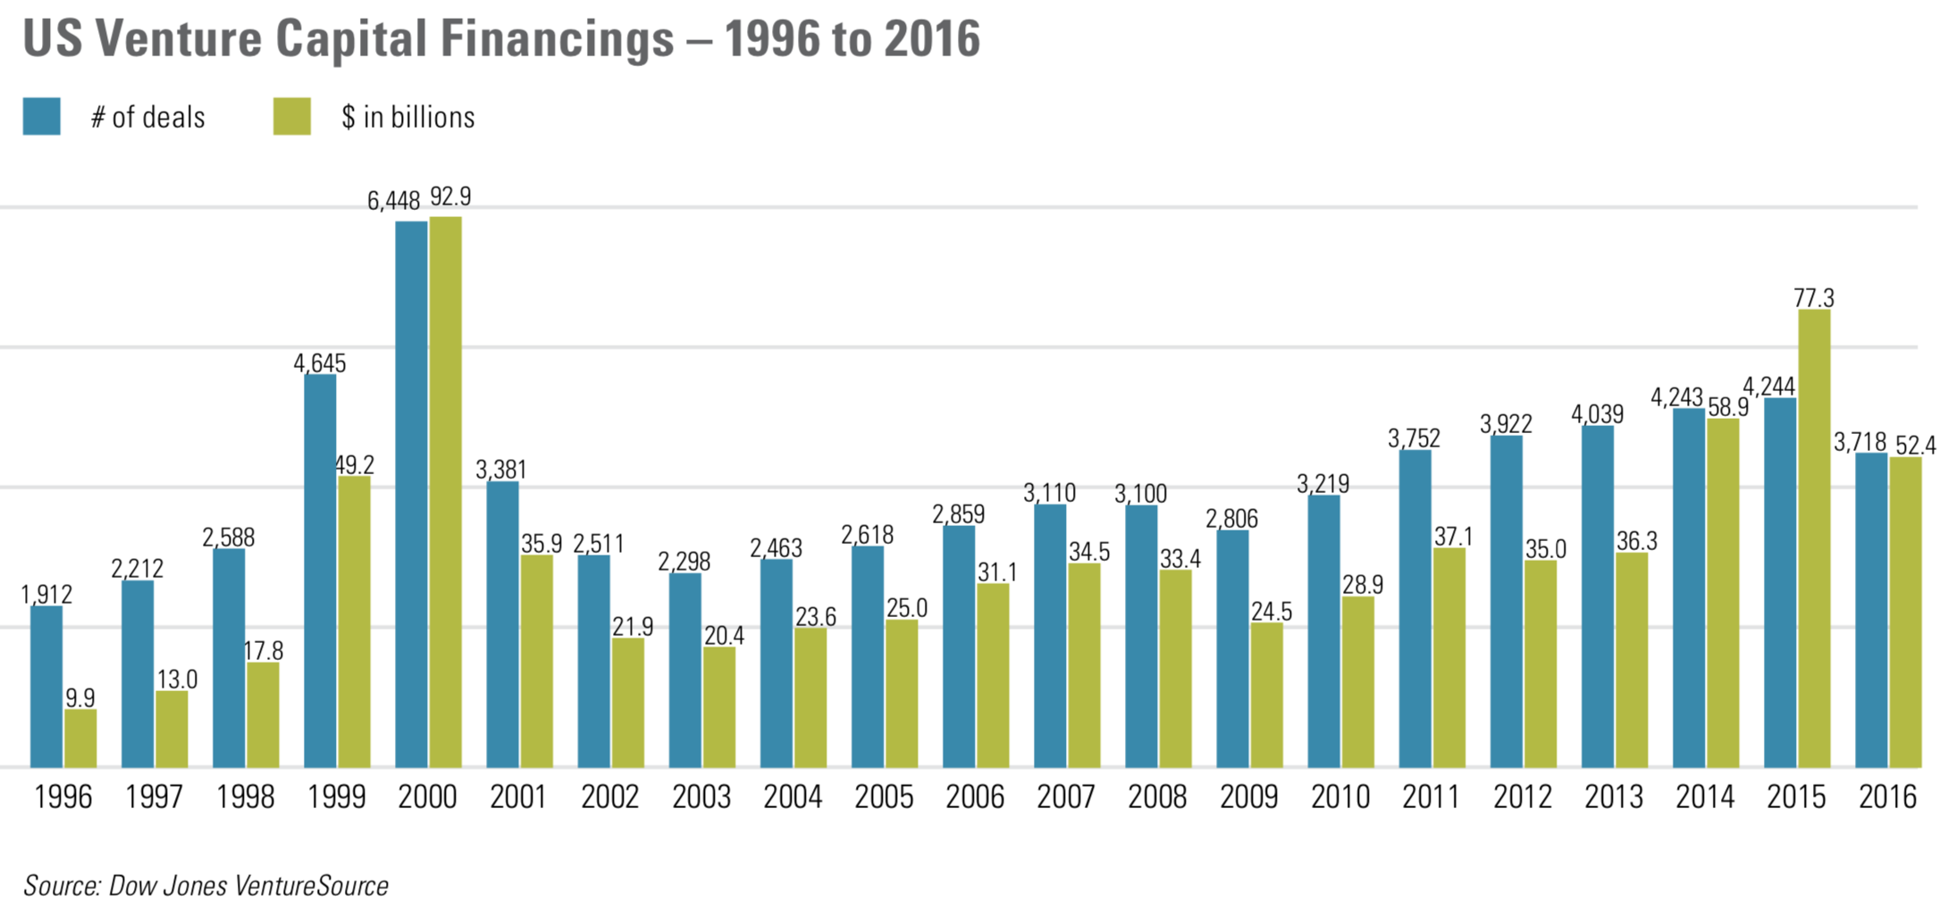
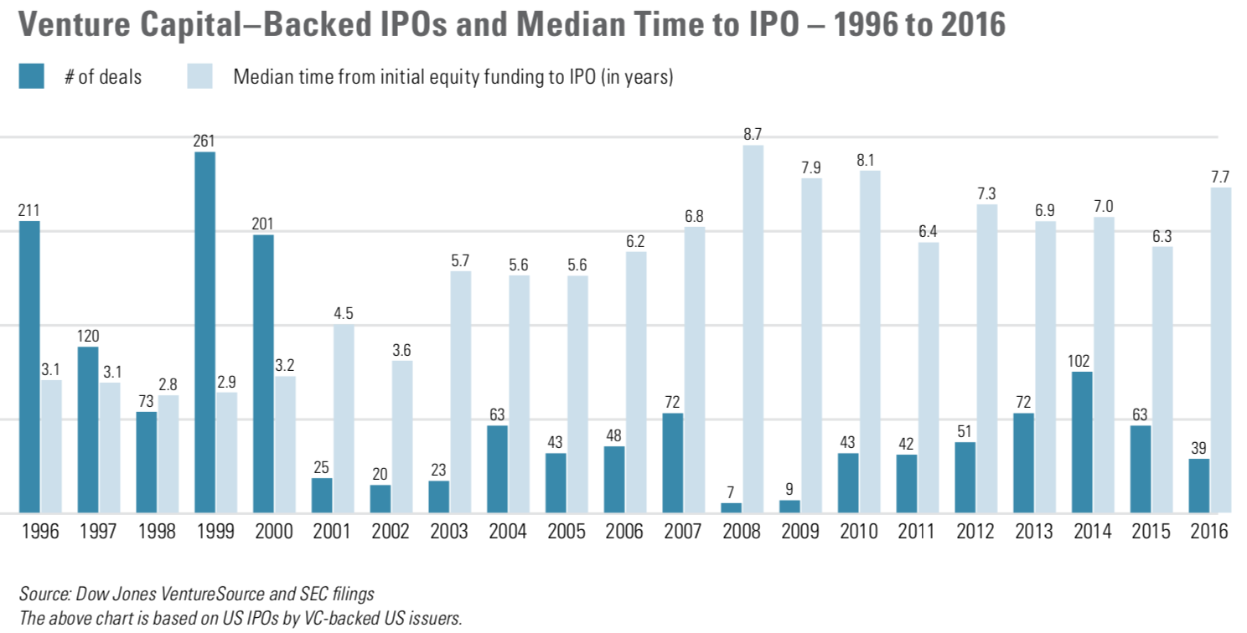

The problem
For a VC, how do we improve the accuracy of investments?
Based on info of founder + startup, we predict the potential of success (raises Series B or more)
Notes:
Alex
2016: $57 million in funding → ~3700 startups received funding → median time to IPO is 7 years → 1% success rate (39 companies went public)

Slide 3



The team
Strong technical background + startup & consulting experience
Alex
Anny You
Surya Sendyl
Lorenzo Ong
Mert Gurkan
Hytiroglou
Nakagawa
Dimitrios
Data Analyst + Industry Engineer + VC Assistant
Data Scientist + Product Manager + Startup Advisor
Industrial Engineer + Database Developer + Graphic Designer
Data Scientist +
ML Specialist +
Data Journalist
Industrial Engineer + Data Scientist + Consultant
Product Manager + Data Scientist + Consultant
Notes:
Alex

Slide 4
Overview
User Interface
Project Lifecycle
The Learning Path
Founder Survey
Data Analysis
Conclusion

Slide 5
User Interface
Proposed UI, Developed Efforts

Slide 6

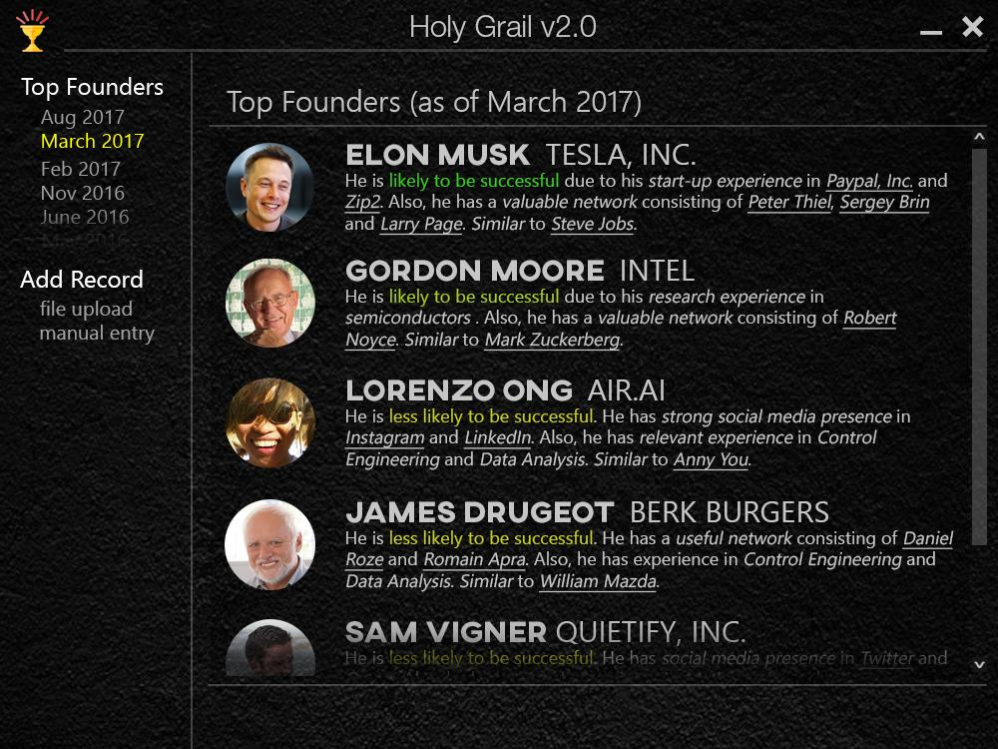
Proposed UI
Notes:
Alex

Slide 7
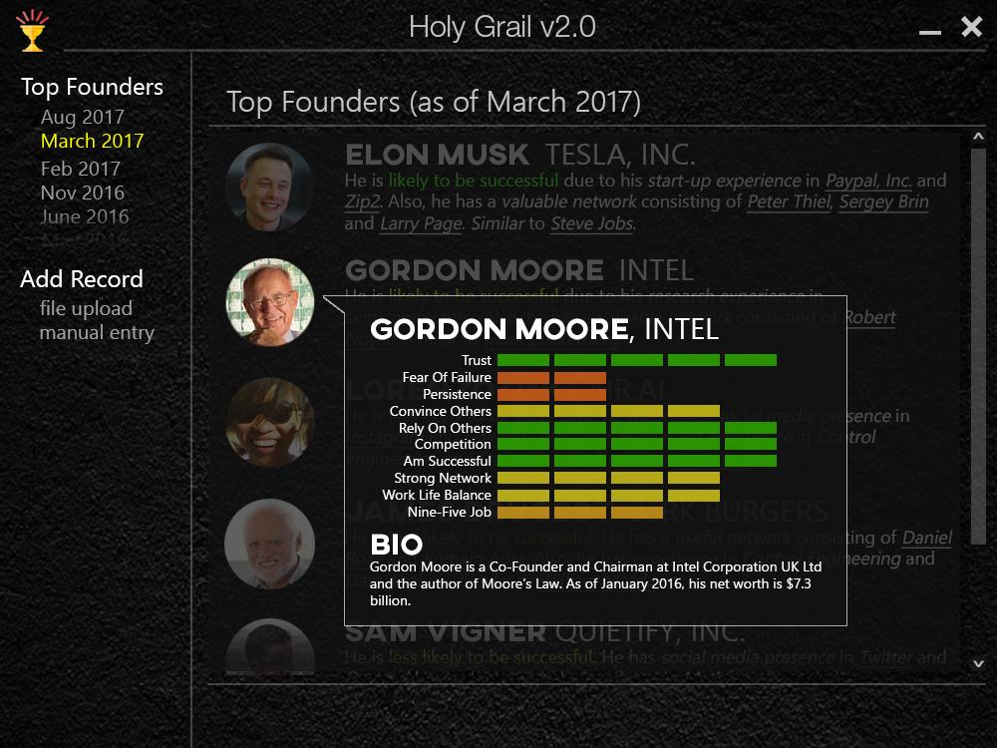
Proposed UI
Notes:
Alex

Slide 8
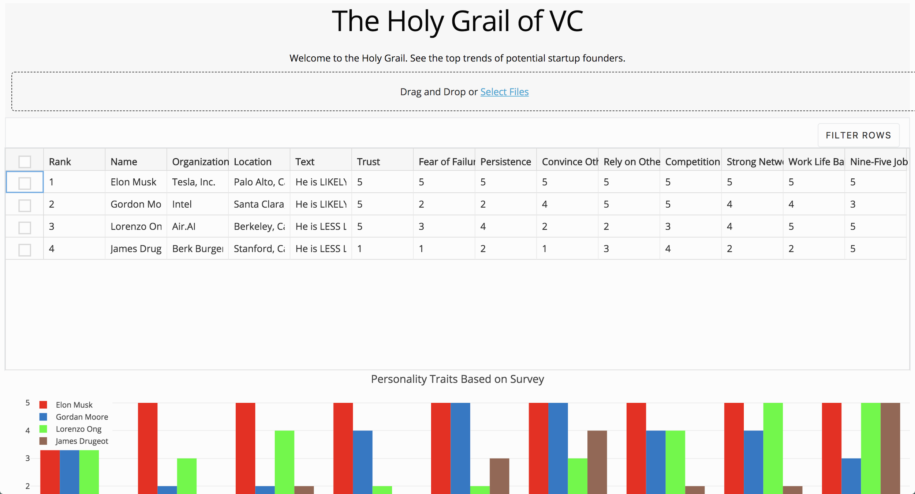
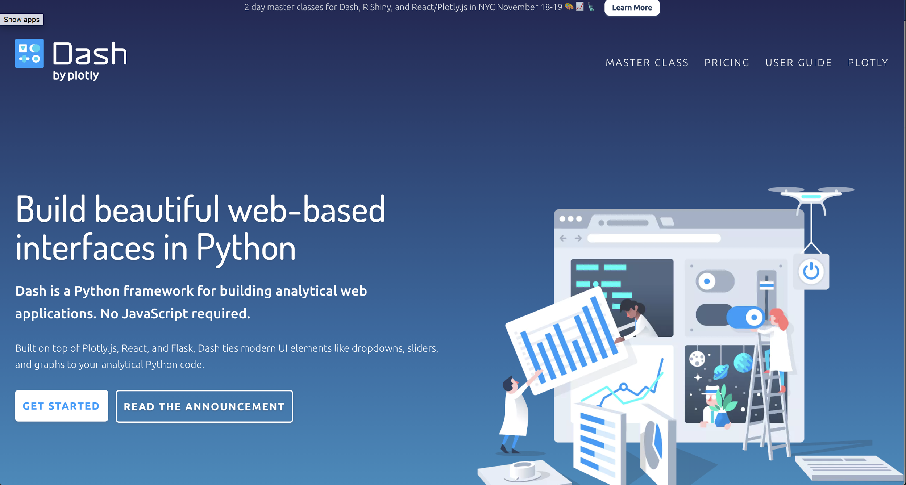
Developed UI
Notes:
Alex

Slide 9
Project Lifecycle
Our Approach, Architecture of Solution

Slide 10
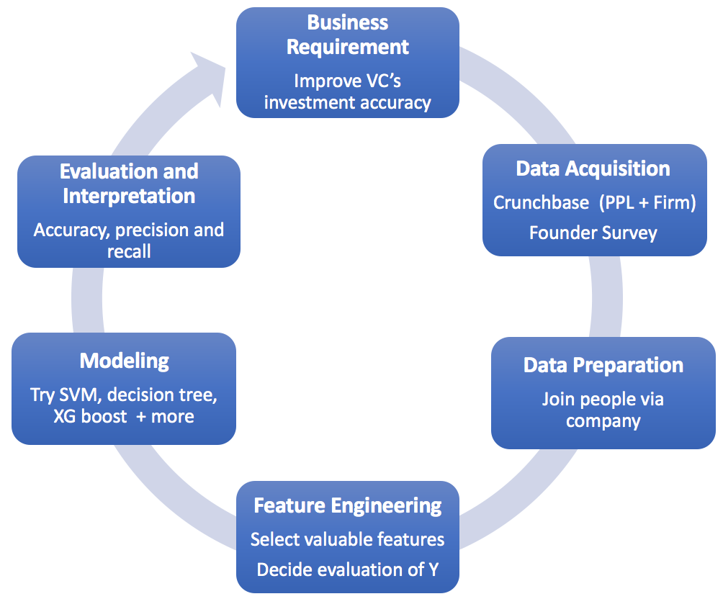
The Approach
A typical life cycle of an ML project
Business Requirement
Improve VC’s investment accuracy
Evaluation & Interpretation
Accuracy, precision & recall
Data Acquisition
Crunchbase (ppl + firm)
Founder Survey
Modelling
Try SVM, decision tree, XGBoost and others
Data Preparation
Join datasets
(people via company)
Feature Engineering
Select valuable features
Decide evaluation of Y
Notes:
Mert

Slide 11
Architecture
of Solution
Input Data (.csv)
Build model (ipython)
Crunchbase company data (~100k rows)
Crunchbase people data (~100k rows)
numpy (arrays)
pandas (dataframes)
excel (.csv)
Output
Scikit-Learn
Apply train-test split
Tokenize (CBOW, TF-IDF) bio data
Test logistic regression, SVM, perceptron, naive bayes, xgboost, random forest*
Apply regularization
Calculate accuracies, confusion matrix
Web UI w/ ranks
Join & subset for only current founders
(~60k rows)
Tables split by industry
Top contributing features for each founder
Clean: drop NaN, recode into categorical
(~25K rows)
Most similar founders
Feature engineering:
select best features, build independent variable
(8 features, 1 output)
matplotlib
(plot accuracies, ROC curve)
Links to Linkedin/CB
Founder psychological factors survey data (~40 respondents)
Calculate probability of success for survey respondents given feature X
Notes:
Surya

Slide 12

The learning path
Dilemma to define business need
Dilemma: Predict success of a potential future-founder OR a current founder+startup?
Spoke to Patrick Chung (VC) + Kevin Liu (angel) -> They advised us that the latter is more of a problem for VCs/angels
Notes:
Ani

Slide 13
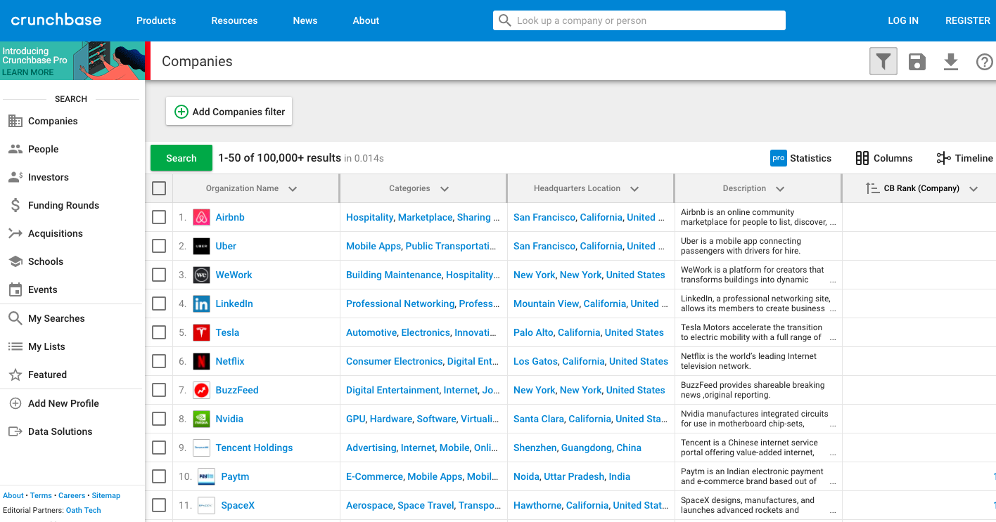
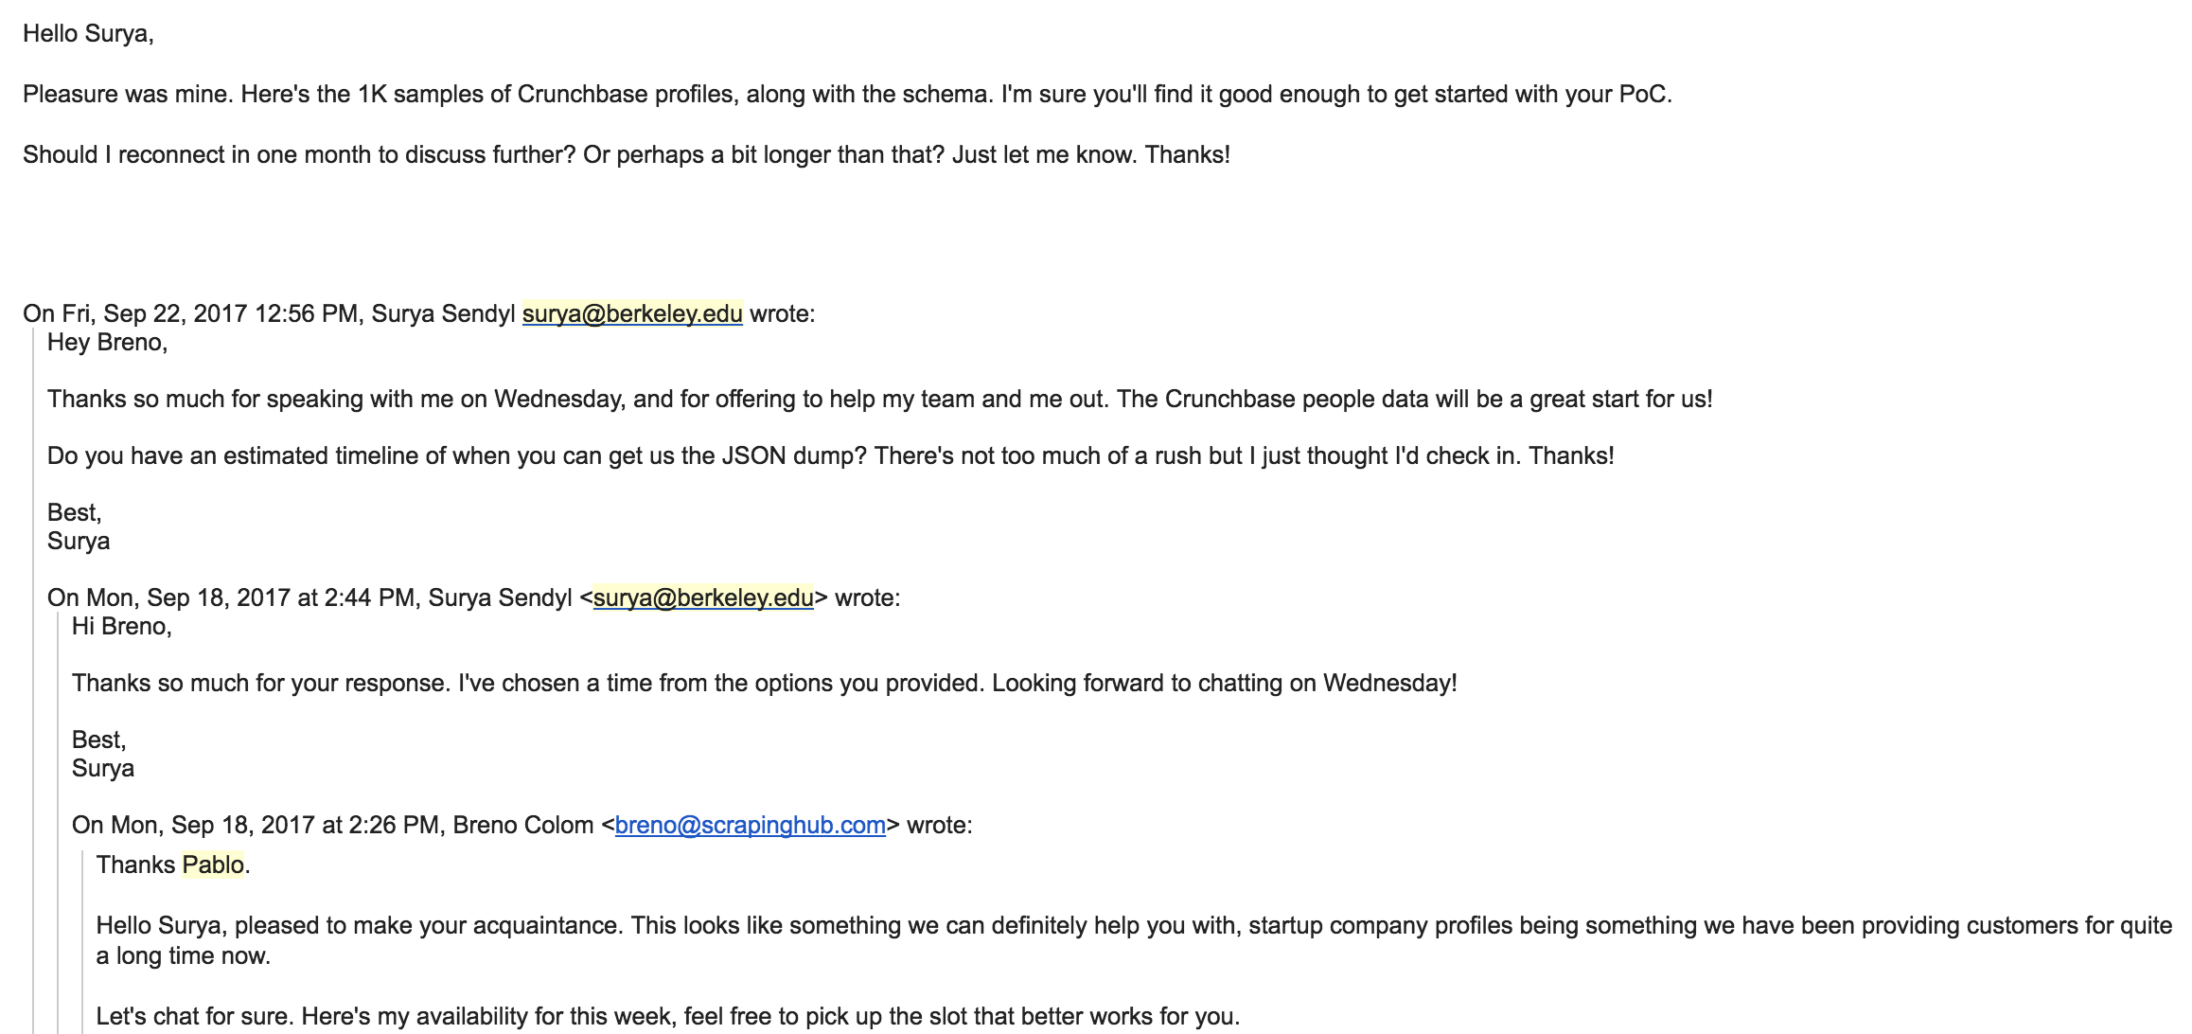
The learning path
Where can we get data?
Can I haz sum data plz?
Reached out to scrapinghub
Got JSON dump of 1.5k Crunchbase profiles (failed)
Tried scraping/downloading:
Angellist, Linkedin, Pitchbook, Mattermark (failed)
Settled on Crunchbase:
sorted by CB rank
manually exported 100k rows of people & company data (success)
Notes:
Ani

Slide 14
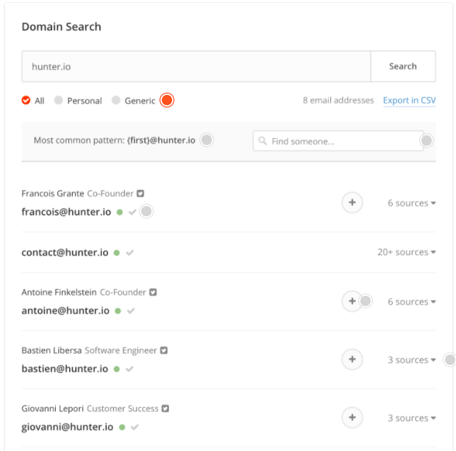
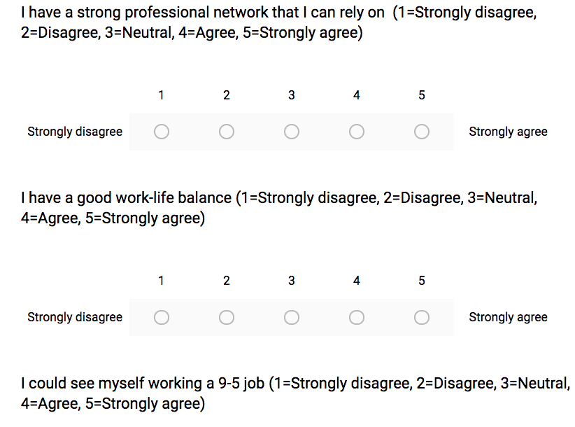
The learning path
Create Survey to get more data resources
Explore non-objective, non-3rd party data sources:
We asked: how do we avoid deferring solely to crunchbase data?
Decided to send out a survey to capture first-person psychological traits of successful founders (~50 responses from 2k+ cold emails)
Used crunchbase to get founder names + companies and hunter.io to get contact emails
Notes:
Ani

Slide 15

The learning path
Using various tools to clean data
Data wrangling:
This was tedious: Crunchbase data is messy (strings in int columns, ints/floats in string columns, many missing values, many duplicates)
Pandas, numpy and excel to join and clean data (~25k rows left)
Notes:
Ani

Slide 16
The learning path
Brainstormed to decide output variable (binary for ‘raised Series B or higher’)
Decided potential features, then used pandas and excel to recode
Feature engineering:
Notes:
dimitri

Slide 17

The learning path
Now the fun part:
We each used the cleaned dataset to test out various models using scikit-learn (success) and tensorflow (failed)
Winner (highest accuracy) gets $1 in BTC
Used: XGBoost, Random Forest, Logistic regression, SVM, Perceptron
RF achieved highest accuracy (~77%)

Slide 18

The learning path
Improving the results:
Tried Auto-sklearn hosted on AWS (failed)
Looked into mining the biography data
Tried bag-of-words and TF-IDF vector representations using Scikit-Learn
Lack of computational power was a problem given the large dataset

Slide 19
The learning path
Improving the results:
Incorporated normalization to reduce overfitting & improve accuracy
Since HQ Location is a categorical var. with over 1000 levels, we changed these values to the frequencies of that particular location
Primary Job Title column had couple of different titles for each person (such as “CTO, co-founder, Product Manager”).
Convert these to a binary variable that shows whether the person is the founder or not
Notes:
mert

Slide 20
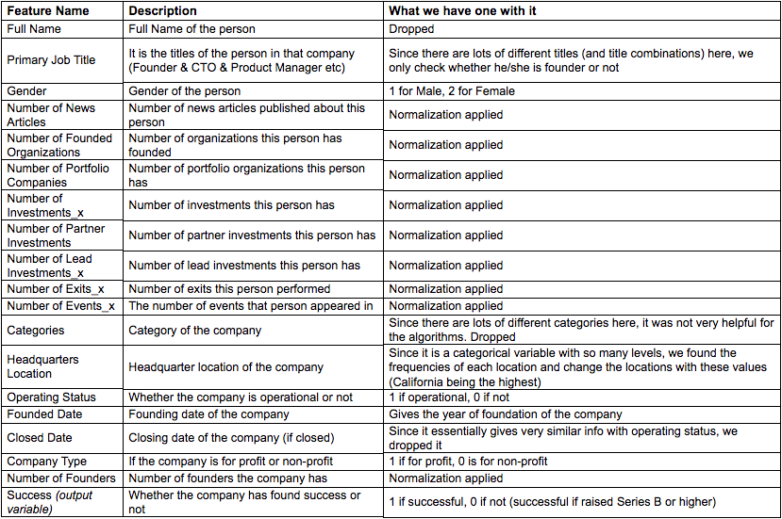
Features

Slide 21

The learning path
How to incorporate the survey data?
Thought about mapping survey data (n=38) to others (n=~25K) in our dataset based on similar crunchbase features
Decided this would not be an accurate representation given the drastic difference in n
Spoke with Ikhlaq: He suggested looking at psychological survey data separately
We calculate the correlation of success given a survey feature (applies only to survey respondents)
Notes:
Surya

Slide 22
Survey
Gathering psychological traits of Founders

Slide 23
Collecting survey data
Crunchbase
to download top 100k founders
Hunter.io
to get emails of founders
Email founders
Google survey
to collect responses
100,000
Only 1k profiles per download
2,000
Each free account gives 100 emails
> 20 accounts created
> 2000 emails sent
1,100
55% of emails went through
> 1100 valid emails
… 50 responses
(Gordon Moore responded!)
Notes:
Lorenzo

Slide 24
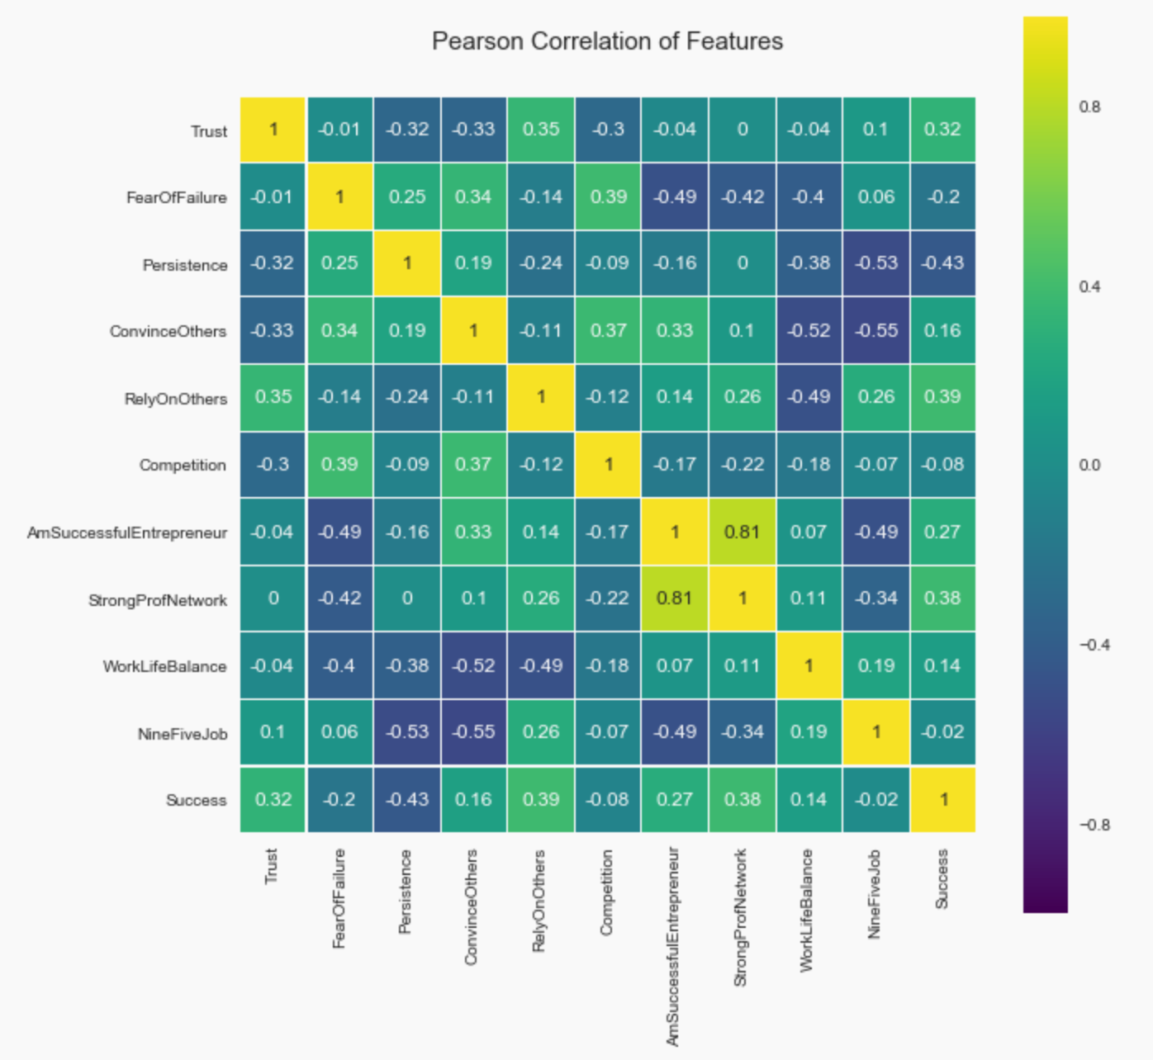
Survey results: Psychological features
Trust in others
Fear of failure
Persistence
Ability to convince others of one’s vision
Comfortable to rely on others
Motivated by competition
I am successful
Strong professional network
Good work-life balance
Can work a 9-5 job
Success
Notes:
Lorenzo

Slide 25
Survey results: Correlation Analysis
Highest correlation to “success”
“I find it easy to trust people”
“I am comfortable relying on others in situations where I am not as capable.”
“I have a strong professional network that I can rely on.”
Notes:
Lorenzo

Slide 26
Survey results: Correlation Analysis
Highest negative correlation to “success”
“I have continued working on a problem despite several continuous setbacks.”
Notes:
Lorenzo

Slide 27
Survey results: Correlation Analysis
Highest correlation
“Having a strong professional network”
“I am a successful entrepreneur”
“Success” vs
“Perceived Success”
0.27 correlation between our metric and the surveyed question on success
Notes:
Lorenzo

Slide 28
Results

Slide 29
Results
 | XGBoost | Random Forest | Logistic Regression | SVM | kNN
Training Accuracy | 79.39 | 94.08 | 60.98 | 74.47 | 83.74
Testing Accuracy | 76.88 | 77.45 | 61.11 | 74.85 | 72.71
- Using a train/test split of 80/20
Notes:
Mert

Slide 30
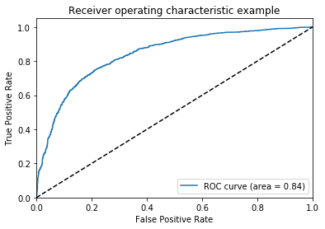
Results

Slide 31
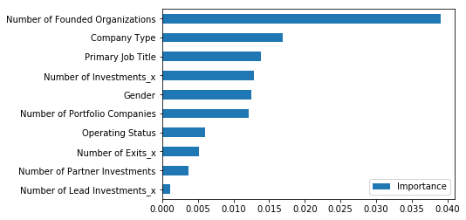
Results

Slide 32
Results: Alternative approach
Interestingly, by following a less orthodox approach we get slightly better results...
 | XGBoost | Random Forest | Logistic Regression | SVM | kNN
Train Accuracy | 95.6 | 99.96 | 61.15 | 89.37 | 88.91
Test Accuracy | 82.98 | 80.32 | 59.98 | 76.69 | 76.72
- Using a train/test split of 80/20
Notes:
Mert

Slide 33
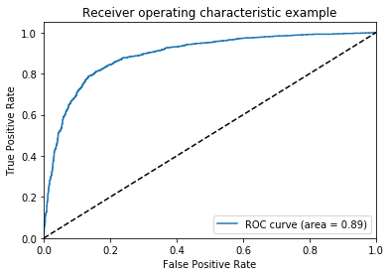
Results: Alternative approach

Slide 34
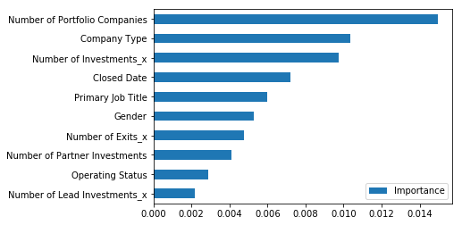
Results: Alternative approach

Slide 35
Final thoughts
Putting it all together:
Built out potential UI
Cleaned, commented, pushed code
Sorted founder data by industry
Put slides together
Notes:
Surya

Slide 36
Future Work & GitHub Link
Distinguish Industry Categories
Improve Success Representation
Get More Non-Objective Data
Link:
List of features and what we did to each of them
Founder Psychology Survey
FIND OUR GITHUB LINK HERE
Notes:
Surya

